Slide 1
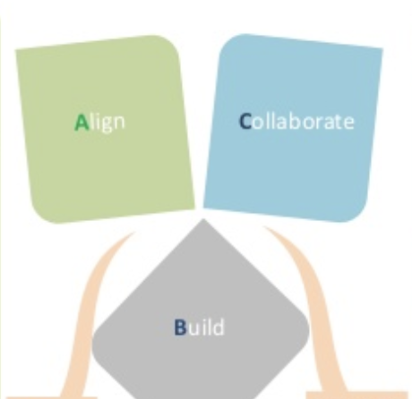
Large Scale Data Collection, Preprocessing and Article Duplication Detection in Spark
Harsh Verma
Software Development/Data Scientist

Slide 2
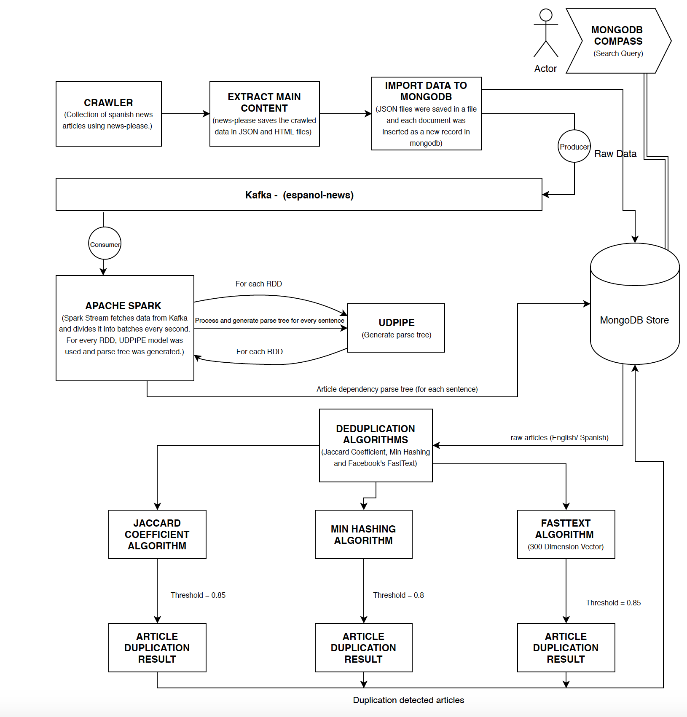
Project Architecture Diagram :

Slide 3


Let’s Jump To DEMO :

Slide 4
Approach I : Jaccard Distance
Report from one of the trails:
Building Shingles for the news articles – Shingle is a sequence of tokens from a given text data. The set of unique shingles from a document is known as w-shingling, where ‘w’ denotes the length of shingles
Computing Jaccard distance with the shingles generated to find out the level of similarity between any two pairs of news articles JS(A, B) = |A ∩ B| / |A ∪ B|
Given a set A, the cardinality of A denoted |A| counts how many elements are in A. The intersection between two sets A and B is denoted A ∩ B and reveals all items which are in both sets. The union between two sets A and B is denoted A ∪ B and reveals all items which are in either set. Jaccard distance gives single numeric score to compare similarity between two articles. Higher the JS value, higher is the similarity between documents.
The news id pairs are identified as duplicate of each other, if the JS value is above a threshold value. In our case, we have fixed it to be 0.85. For all possible news id pairs, if similarity value is above 0.85, they are classified as duplicate of each other and these results are used for clustering.
 | Predicted - True | Predicted - False
Actual - True | TP (21) | FN (4)
Actual - False | FP (0) | TN (30)
Accuracy: 0.9272727272727272
TP - 21, FP - 0, TN - 30, FN – 4

Slide 5
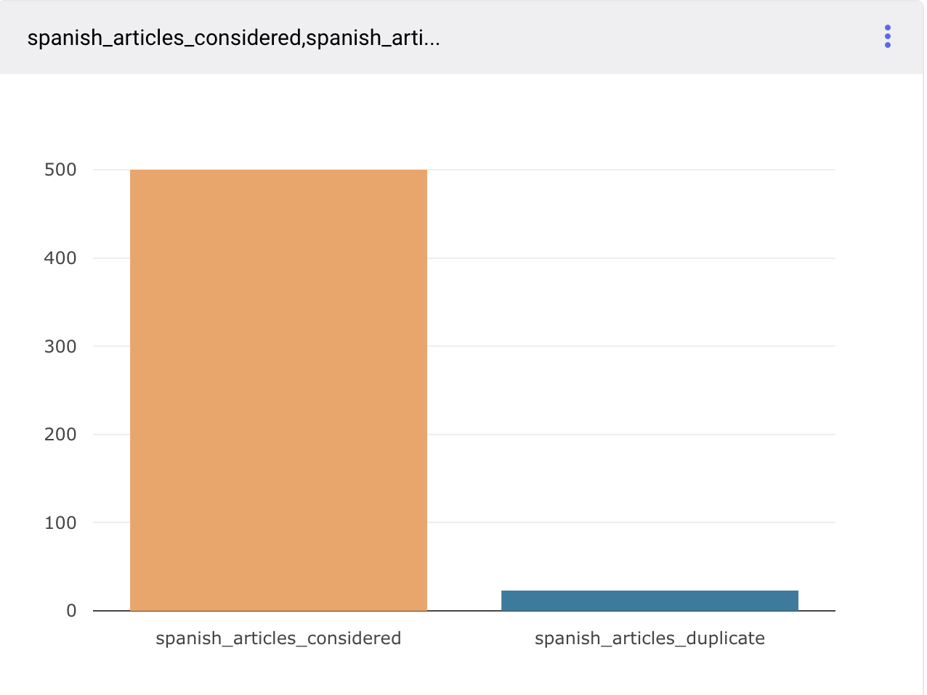
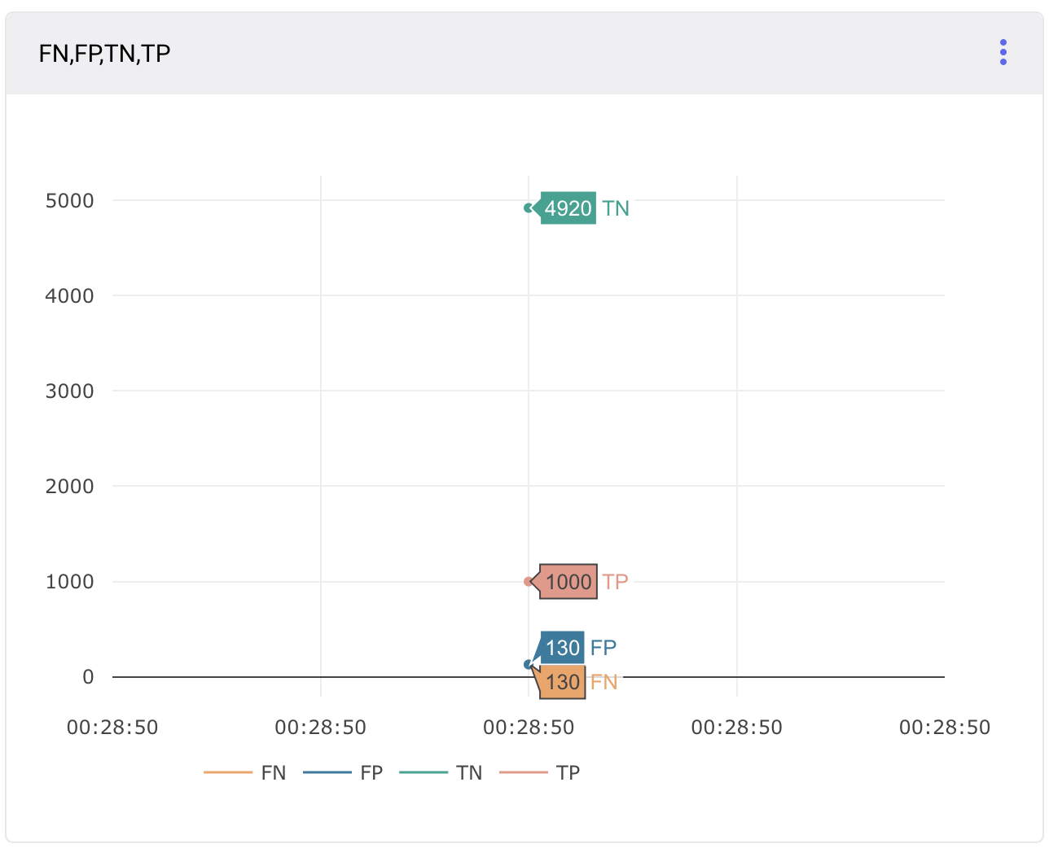
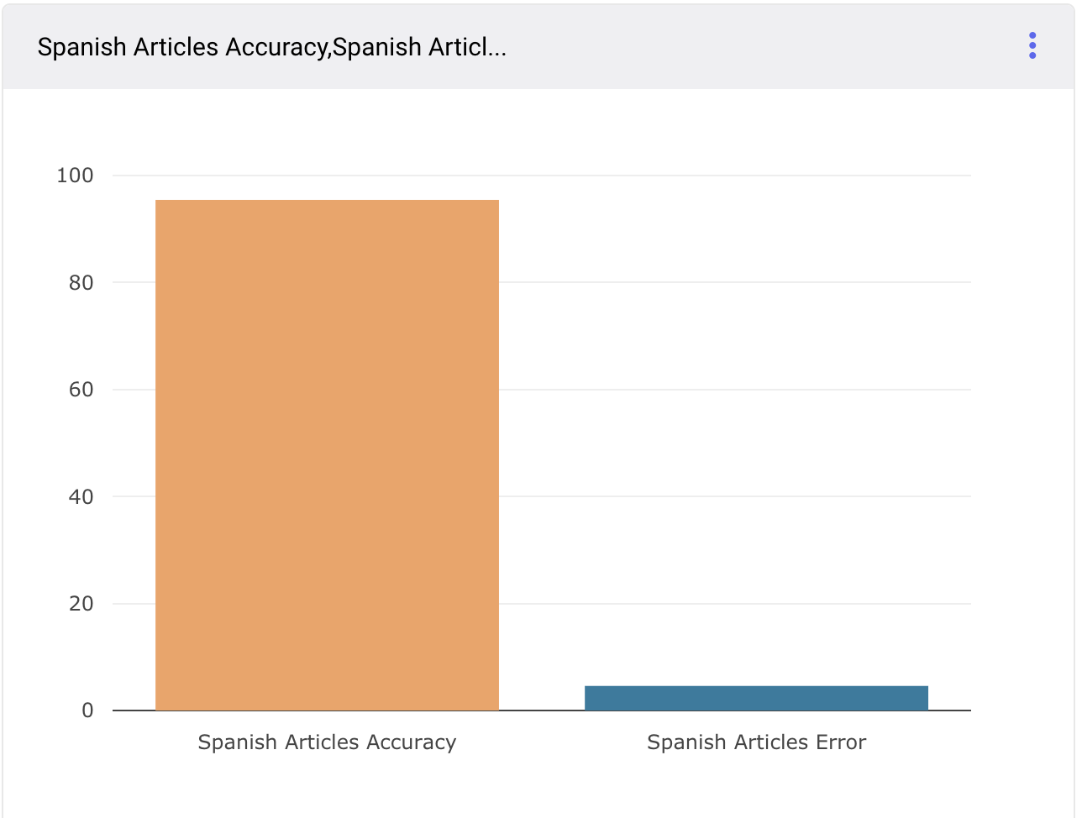
Result Jaccard Similarity:
Comparison Chart of total to duplicate detected articles
Comparison Chart of Performance Evaluation metric : True Positive , True Negative, False Positive and False Negative Results
Comparison Chart of Accuracy and Error Percent duplicate detected articles

Slide 6
Approach II : Min Hashing
Min hashing technique is randomized algorithm to quickly estimate Jaccard similarity between two sets
Min hash signatures are generated for each document. Min hash signatures will have fixed length independent of the size of the set. To approximate similarity between two sets, count the number of similar components in each Min hash signature. Dividing this count by signature length gives a good approximation of Jaccard similarity between two sets
Min hash signatures are generated using hash function
Report from one of the trails:
Accuracy Ranges from 40% -75 %, Takes more time than Jaccard Similarity Algorithm
Accuracy: 0.472727272727272
TP - 21, FP - 25, TN - 5, FN - 4
 | Predicted - True | Predicted - False
Actual - True | TP (21) | FN (4)
Actual - False | FP (25) | TN (5)

Slide 7
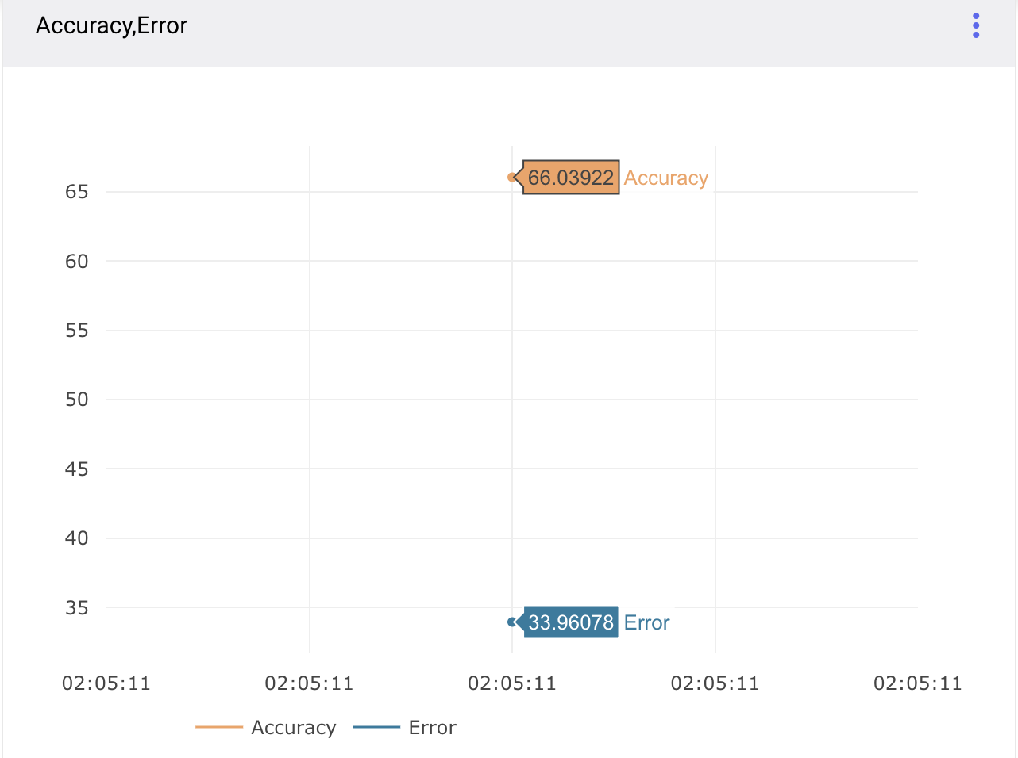
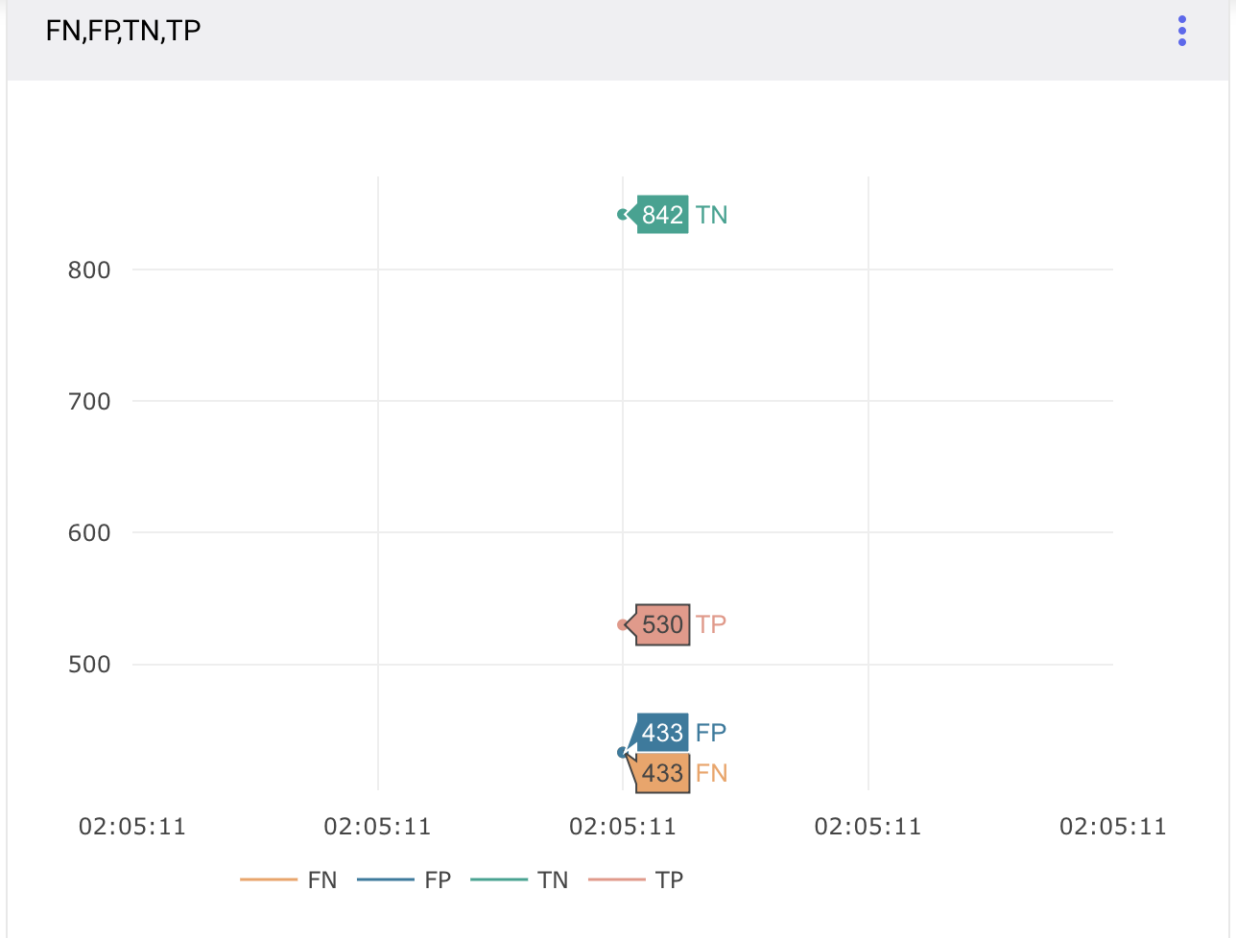
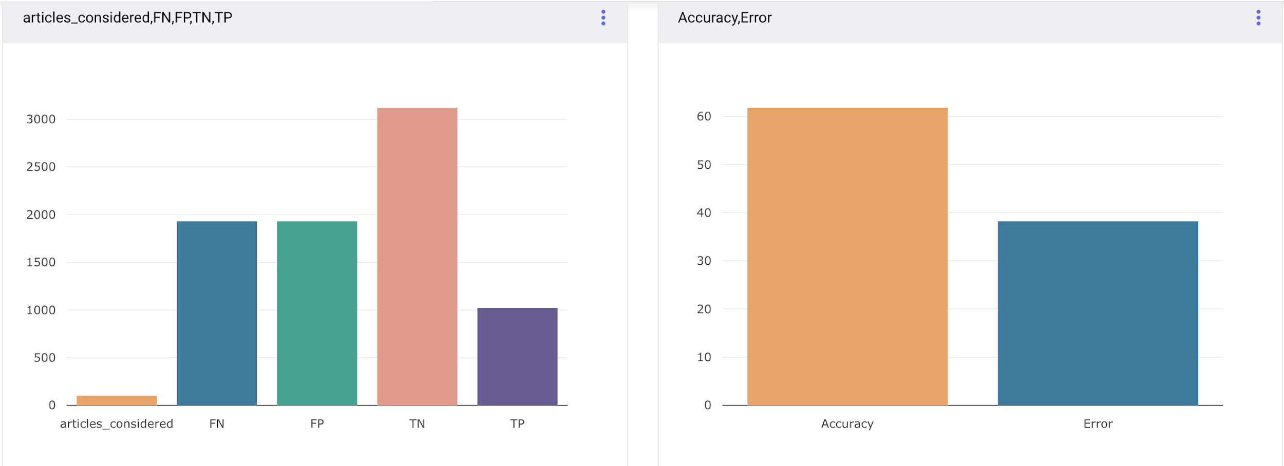
Min-Hash Technique Result:
Min-hash Technique Comparison Chart of Accuracy and Error Percent duplicate detected articles
Min-Hash technique : Comparison Chart of Performance Evaluation metric : True Positive , True Negative, False Positive and False Negative Results

Slide 8

Approach III - Fast Text
Fast Text is an open source library created by Facebook which has pre-trained vectors on various languages.
These pre-trained vectors can be used to create dictionaries which can directly be used for word embeddings. The vectors have dimension of →
1 x 300.
The advantage of using FastText library is that it is trained on an enormous wikipedia dataset & hence the vectors can have better learning of the semantics for given text.
To find similarity we used the following approach:-
Cosine Similarity:-
To find cosine similarity, the document vectors obtained the in the previous steps are reduced to dimensions of 1x 300 by taking average values of all columns.
These vectors of the two documents whose similarity is to be determined are passed to cosine similarity function.
Cosine similarity of >0 indicates partial similarity of documents. Cosine similarity of 1 indicates strong similarity & -1 indicates strong dissimilarity. Negative value indicates dis-similarity.

Slide 9
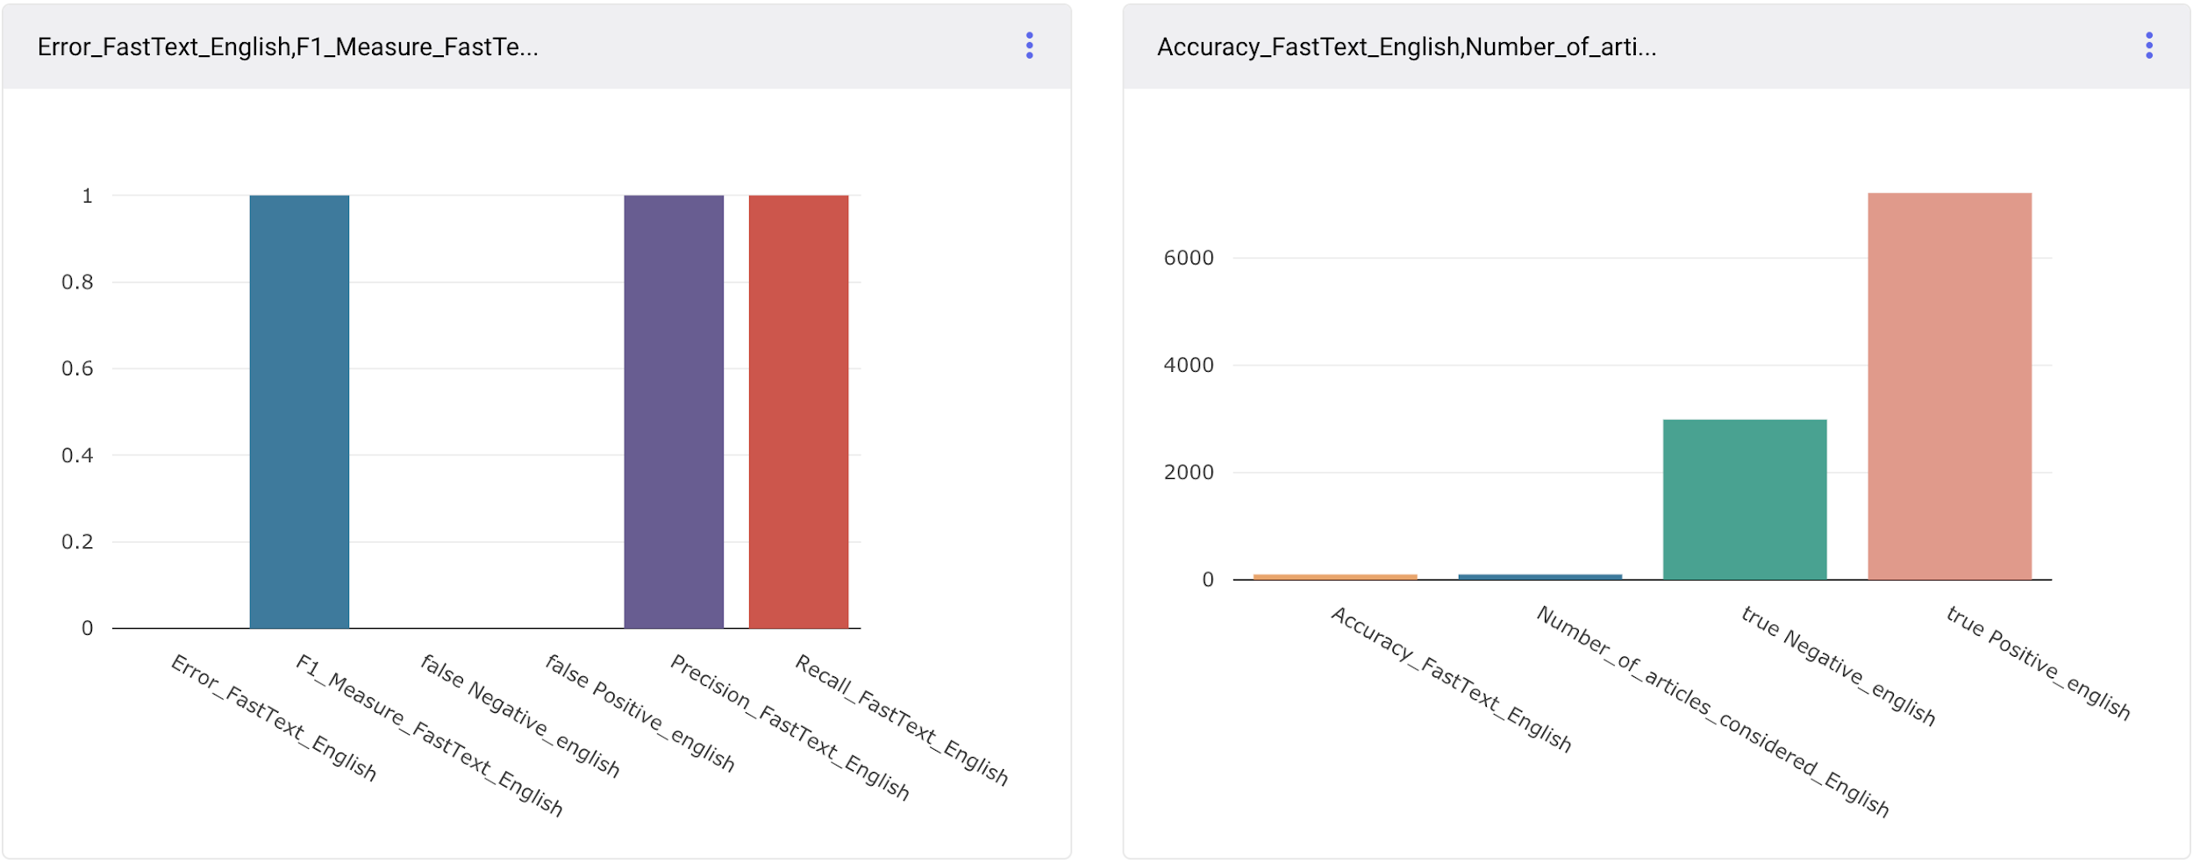
Result Fast Text English Articles: (Improved Accuracy, More Time)
Fast-Text Vectorization technique : Comparison Chart of Performance Evaluation metric : True Positive , True Negative, False Positive and False Negative Results

Slide 10
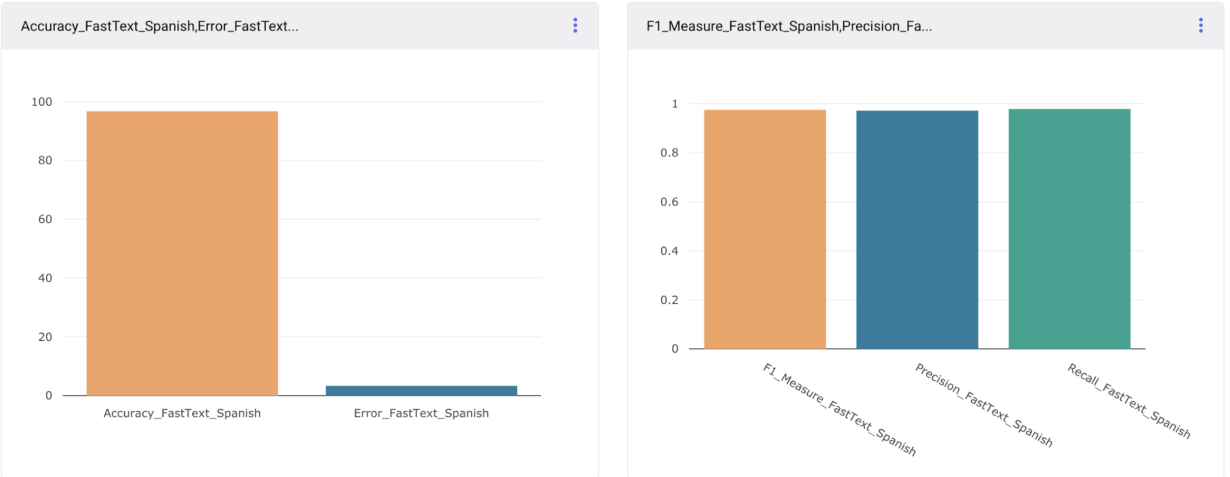
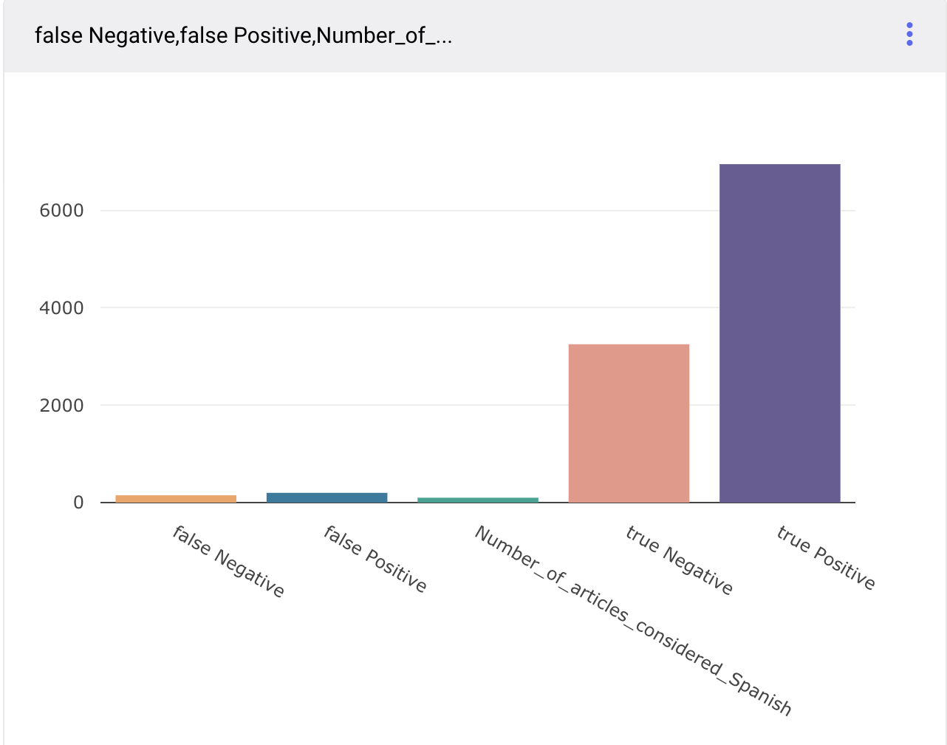
Performance Result Fast Text : Spanish Articles
English Data Fast-Text Vectorization technique : Comparison Chart of Performance Evaluation metric : True Positive , True Negative, False Positive and False Negative Results along with F1 Score, Accuracy, Recall

Slide 11
Common Challenges:
Improving the accuracy of the deduplication algorithms (min hashing and jaccard distance), which we were able to improve using fast text approach.
Handle crawling of articles that were written or modified on the same day as they were crawled.
Finding the folder structure and the pattern of data storage in news-please repository.
Spark Streaming Integration with UDPipe.

Slide 12


Slide 13


